Slide 1

ECE2050 Digital Logic and Systems Tutorial 3
YAO Junguang
Contact: junguangyao@link.cuhk.edu.cn
Office Hour: 14:00-15:00 Tuesday, Rx902

Slide 2
Logic Gate
Logic gate
Some techniques about logic gate

Slide 3
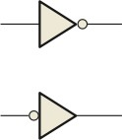

Logic Gate
Inverter
Input number: 1
Distinctive shape
Logic expression
Truth table
𝑋 = 𝐴

Slide 4
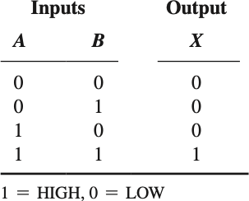

Logic Gate
AND gate
Input number: more than 1
Distinctive shape Logic expression
Truth table
𝑋 = 𝐴𝐵

Slide 5
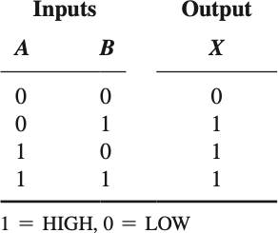

Logic Gate
OR gate
Input number: more than 1
Distinctive shape Logic expression
Truth table
𝑋 = 𝐴 + 𝐵

Slide 6



Logic Gate
Q1 Draw a truth table for the combination of gates below
A B
Output
C

Slide 7
Logic Gate
Q1 Draw a truth table for the combination of gates below
A1
Truth Table
A B
A | B | C | Output
0 | 0 | 0 | 0
1 | 0 | 0 | 1
0 | 1 | 0 | 1
1 | 1 | 0 | 1
0 | 0 | 1 | 0
1 | 0 | 1 | 0
0 | 1 | 1 | 0
1 | 1 | 1 | 0
Output
C

Slide 8

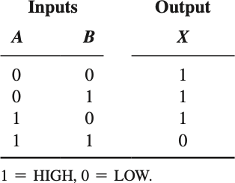

Logic Gate
NAND gate
Input number: more than 1
Distinctive shape Logic expression
Truth table
𝑋 = 𝐴𝐵
= 𝐴 + 𝐵
De Morgan's Laws

Slide 9

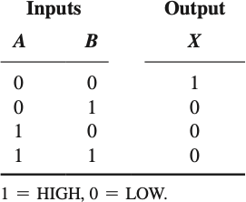
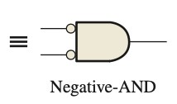
Logic Gate
NOR gate
Input number: more than 1
Distinctive shape Logic expression
Truth table
𝑋 = 𝐴 + 𝐵
= 𝐴 𝐵

Slide 10
Logic Gate
NOR gate and OR gate
NAND gate and AND gate

Slide 11
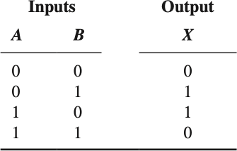

Logic Gate
XOR gate
Input number: usually 2
Distinctive shape Logic expression
Truth table
𝑋 = 𝐴𝐵 + 𝐴𝐵

Slide 12
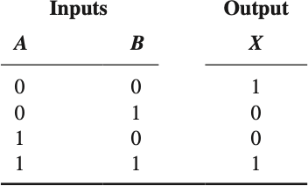

Logic Gate
XNOR gate
Input number: usually 2
Distinctive shape Logic expression
Truth table
𝑋 = 𝐴𝐵 + 𝐴𝐵

Slide 13
Logic Gate
Perform logic functions:
inversion (NOT), AND, OR, NAND, NOR, etc.
Single-input:
NOT gate, buffer
Two-input/Multiple-input:
AND, OR, XOR, NAND, NOR, XNOR

Slide 14
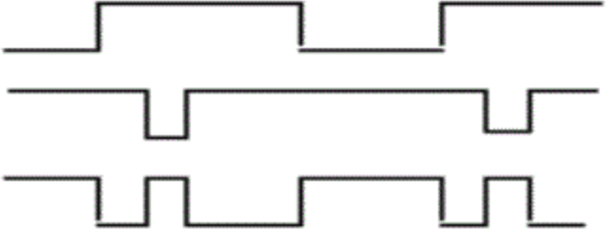
Logic Gate
Q2 What type of the gate that can generate the output waveform by being input A and B? (Multiple choice)
A. AND gate B. XOR gate
A B
Output
C. XNOR gate D. NAND gate

Slide 15
Logic Gate
Q2 What type of the gate that can generate the output
waveform by being input A and B?
A2: BD
A. AND gate B. XOR gate
A B
Output
C. XNOR gate D. NAND gate

Slide 16
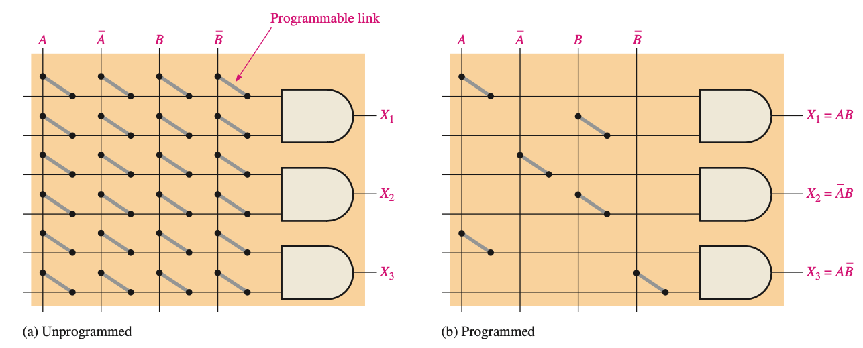
Logic Gate
Programmable Logic
An AND array consists of AND gates and a matrix of interconnections

Slide 17
Logic Gate
Fuse technology (one-time programmable, OTP)
Antifuse technology (OTP)
EPROM technology (Most of them are OTP)
EEPROM technology
Flash technology
SRAM technology

Slide 18
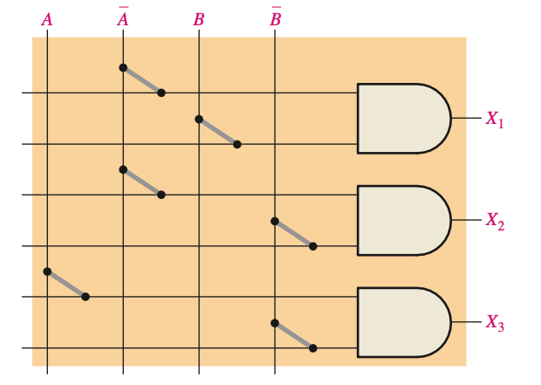
Logic Gate
Q3 In the simple programmed AND array with programmable links shown below, determine the Boolean output expressions.

Slide 19
Logic Gate
Q3 In the simple programmed AND array with programmable links shown below, determine the Boolean output expressions.
A3
𝑋₁ = 𝐴𝐵
𝑋₂ = 𝐴𝐵
𝑋₃ = 𝐴𝐵

Slide 20
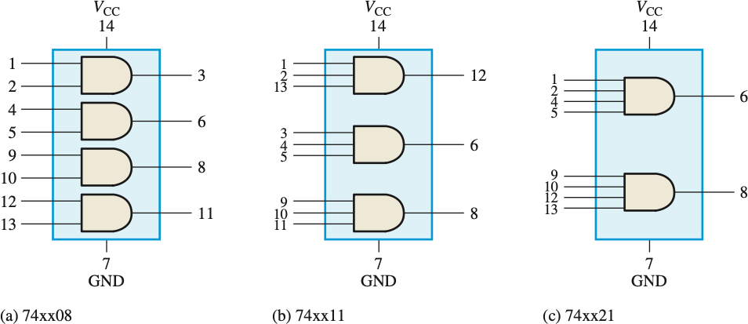
Logic Gate
Fixed-Function Logic Gates
CMOS (Complementary Metal-Oxide Semiconductor)
Bipolar (TTL, Transistor-Transistor Logic)
74 Series

Slide 21
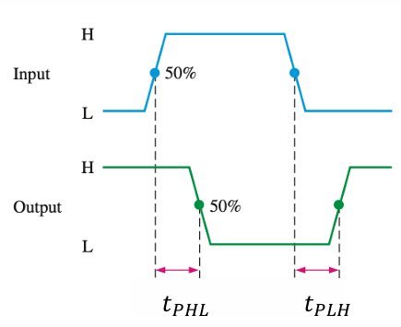
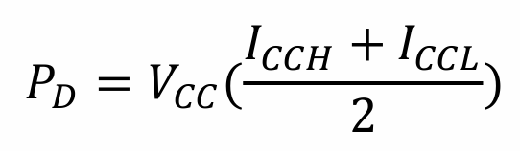
Logic Gate
Performance Characteristics & Parameters
Propagation Delay Time (𝑡_{𝑃𝐻𝐿} and 𝑡_{𝑃𝐿𝐻})
DC Supply Voltage (𝑉_{𝐶𝐶} )
Power Dissipation
Assume a 50% duty cycle since the supply current is
different according to the output of the gate
Current of High Logic
Current of Low Logic

Slide 22
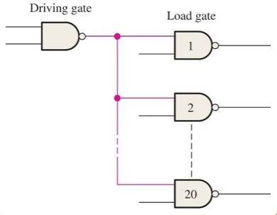

Logic Gate
Performance Characteristics & Parameters
Input and Output Logic Levels(𝑉_{𝐼𝐿}, 𝑉_{𝐼𝐻}, 𝑉_{𝑂𝐿}, 𝑉_{𝑂𝐻})
Fan-Out and Loading
The maximum number of inputs can be connected to a gate’s output and
still maintain the output voltage levels within specified limits

Slide 23
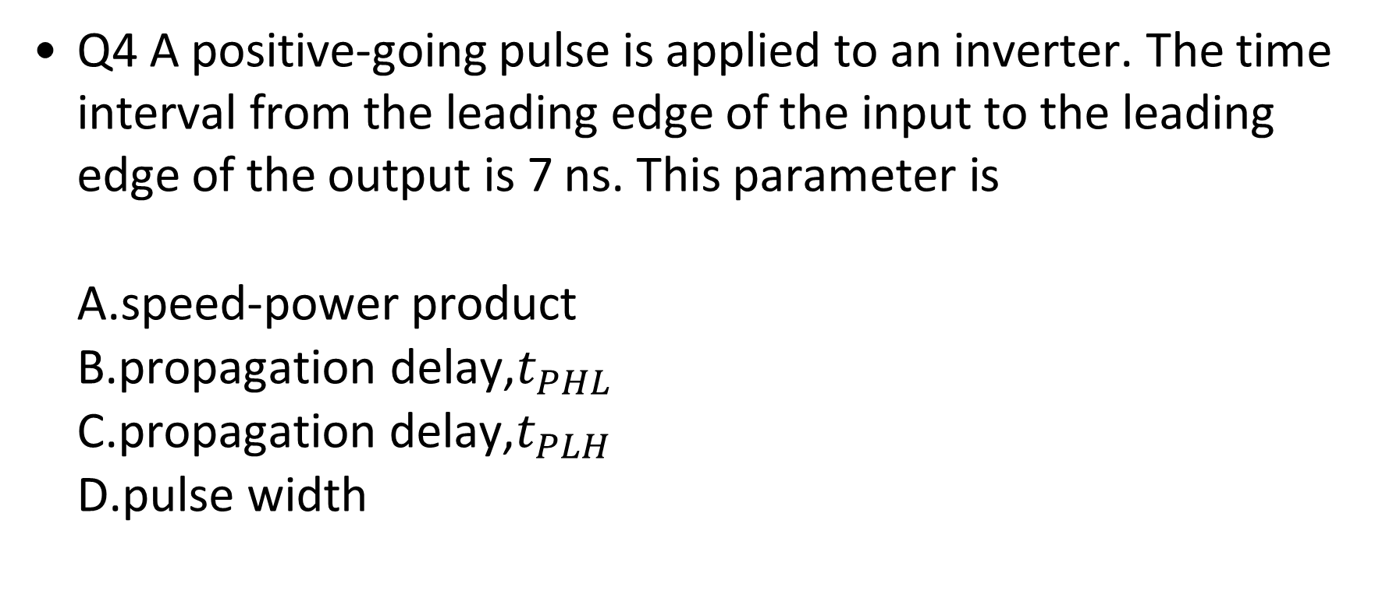
Logic Gate
Q4 A positive-going pulse is applied to an inverter. The time interval from the leading edge of the input to the leading edge of the output is 7 ns. This parameter is
A.speed-power product
B.propagation delay,$t_{PHL}$
C.propagation delay,$t_{PLH}$
D.pulse width

Slide 24
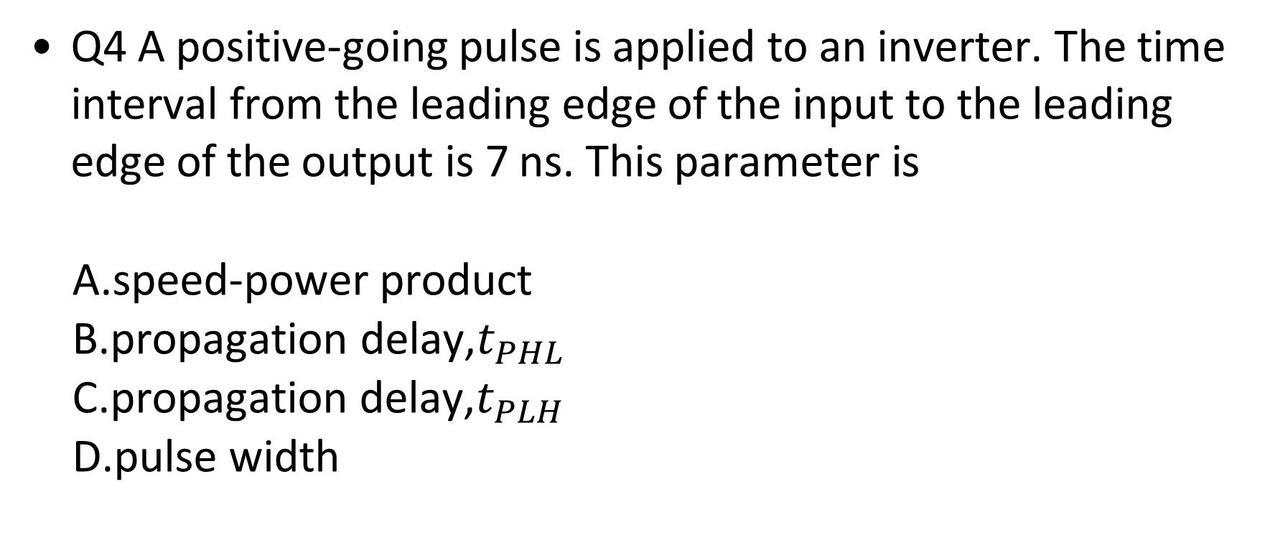
Logic Gate
Q4 A positive-going pulse is applied to an inverter. The time interval from the leading edge of the input to the leading edge of the output is 7 ns. This parameter is
A.speed-power product
B.propagation delay,$t_{PHL}$
C.propagation delay,$t_{PLH}$
D.pulse width
A4 B

Slide 25
Logic Gate
Troubleshooting
The process of recognizing, isolating, and correcting a fault or failure in a circuit or system
Internal failures
External opens and shorts

Slide 26
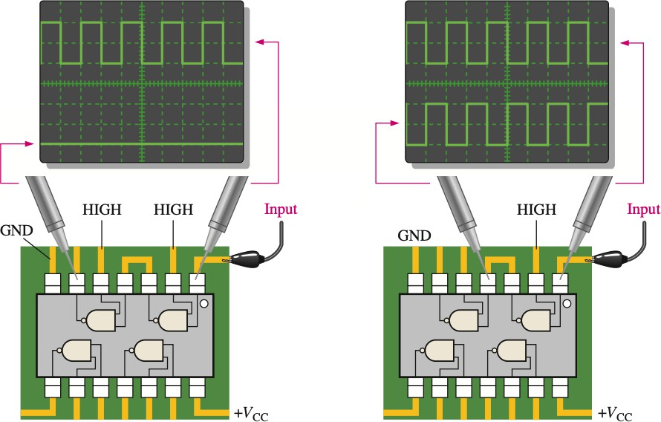
Logic Gate
Q5 Using an oscilloscope, you make the observations indicated in the right side figure. Determine the most likely gate failure.

Slide 27
Logic Gate
A5 From the right figure, the right NAND gate is functional. From the left figure, the most likely problem is
open input
open output
ouput shorted to ground

Slide 28
Q&A

Slide 29
Thank You!

